Slide 1


Wavecon 5G Impact Analysis
Wavecon is a leading telecom provider with a strong presence in the industry, known for its innovative network solutions and customer-centric approach.
This presentation analyzes the impact of Wavecon's 5G launch on revenue, user behavior, and key performance indicators. We'll explore the challenges and opportunities presented by this transformative technology and provide actionable recommendations for maximizing its potential.

Slide 2
Objectives or Problem Statement
what is the Impact of 5G Launch on Revenue?
Which KPI is underperforming post-5G Launch?
Best & Worst Plans Performing Plans Post-5G In terms of Revenue?
Plans Largely Affected by 5G Launch?
Discontinued Plans & Reasons?

Slide 3

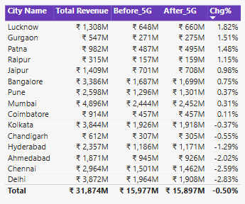
What is the Impact of 5G Launch on Revenue?
Before 5G Revenue
After 5G Revenue
Revenue Change
₹16.0 billion
₹15.9 billion
-0.50%
Top Three cities with change in percentage(%) were Lucknow, Gurgaon, and Patna with 1.82 %, 1.51 %, 1.48 % respectively
Cities like Ahmedabad, Chennai and Delhi were the lowest -2.02 %, -2.59 %, -2.83 % respectively as compared to other cities
While there was a slight decline in revenue post-5G launch, the monthly trend reveals an initial rise, followed by stabilization.
This indicates a need for further analysis to understand user adoption patterns and the impact of 5G pricing strategies.

Slide 4


Which KPI is Underperforming Post-5G Launch?
Before 5G
After 5G
1
Revenue: ₹16.0 billion
1
Revenue: ₹15.9 billion
2
ARPU (Average Revenue Per User): ₹190.2
2
ARPU (Average Revenue Per User): ₹211.3
3
Total Active Users (TAU): 84.4 million
3
Total Active Users (TAU): 77.4 million
4
Total Unsubscribed Users (TUsU): 5.6 million
4
Total Unsubscribed Users (TUsU): 7.0 million

Slide 5
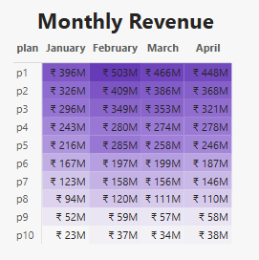
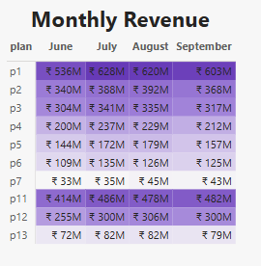
Best & Worst Performing Plans Post-5G
In Terms Of Revenue
High Performing Plans
Low Performing Plans
Plans like P1, P2, P3 & P11 are the highly performing plans post-5G
The company introduced plans 11, 12, 13 after the 5G rollout
Plans like P4, P5, P6 and also P7 & P11 were considered to be the least performing plans post-5G
P8, P9, P10 were discontinued post-5G

Slide 6
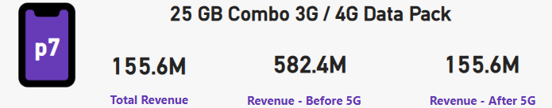
Plans Largely Affected by 5G Launch
1
Plan 7 Got Affected
The Revenue has substantially decreased from 582.4 Million which is Before 5G got launched and the Revenue decreased to 155.6 Million
2
Discontinuation of Plan 7
As high number of users unsubscribing after 5G, it suggests that customers no longer find value out of it
If new 5G plans offer better value (higher data, speed, or features) at a similar price, customers will naturally switch.
If users who were previously on Plan 7 are now opting for premium 5G plans, it indicates that Plan 7 is outdated.

Slide 7


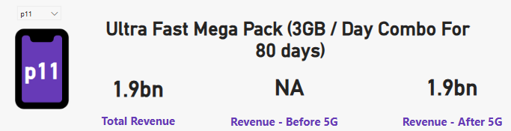
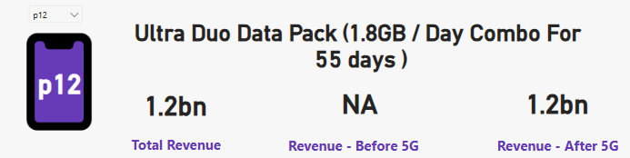
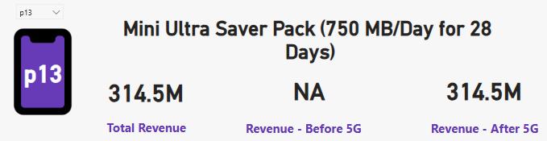
Discontinued Plans & Reasons
Some of the plans which were
discontinued were :
New Plans which were
introduced were :
Plan 8, Plan 9, & Plan 10
Plan 11, Plan 12, & Plan 13

Slide 8

Thank You

